Slide 1
Football Club Transfer market Management system
Min JO

Slide 2
Football transfer market
Summer/Winter Transfer market
Scouting team
Scouters & Staffs
Meeting type (player/agent meeting)
Transfer & Loan

Slide 3
Objectives
Manage football club scouting team
View basic player information
Create schedule table and track the transfer meetings

Slide 4
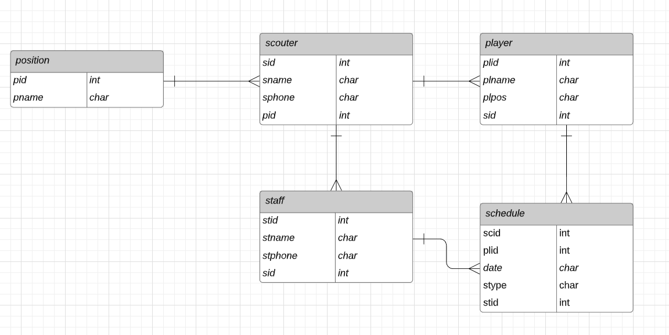
ER Diagram

Slide 5
Functionality
Command Line Program Instructions
Python transfermarket.py [--help] [--version] [--search | --list | --schedule | --count | --register] [name] [plid] [plpos] [sid]
Demo

Slide 6
Future objectives
Develop UI
Add sub options for each command
Agent management

Slide 7
Q&A

